Slide 1
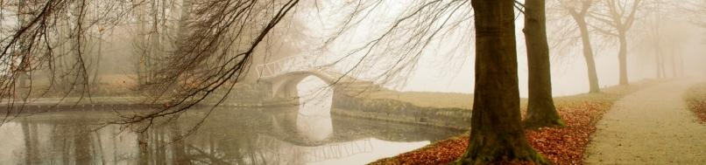
Venezuelan Art and Culture
By Sarah Murvin
No pictures are added, you will find plenty of pictures in my Collage.

Slide 2

Art is the enhancement of every culture represented through different forms of expression. The art and culture of Venezuela is a melting pot of different ethnic tribes and social groups comprised of native population. Each region of the country has its unique food, music and natural tradition which is reflected through its festivals. Art and culture of Venezuela is a mixed assortment of various ethnicity and forms.

Slide 3

A Brief Historical Background
After the conquest of the Spanish colonists, the culture of Venezuela experienced a great change affecting the social, political and economic life of the people living there. The ancient influence of the pre-Hispanic communities was included by the strong cultural agreement of the Spaniards. After the Spanish defeat, the traditional Venezuelan music developed as a blend of Spanish and African rhythms which have been redefined from time to time in order to meet the demands of the new generation.

Slide 4
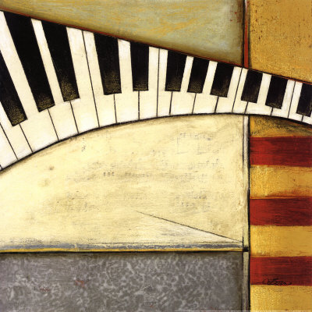
Music and Dance
Venezuela Music obtained a completely new rhythm, which was the gathering of Spanish, African, and the native musical notes and beats. The region that has evidently been influenced by the African music is the north east coast of Venezuela . The ‘Gaita’is the traditional music of Christmas in Venezuela, which is accompanied by four-stringed guitars and maracas. This guitar enhances the rhythmic beat of the most popular art form called the ‘joropo’.
Some of the other important dance forms in Venezuela are ‘merengue’ and Puerto Rican salsa.

Slide 5

Literature
Venezuela literature is also an important aspect of Venezuela Art. Although literature began to gain stronghold on the Venezuelan soil during the colonial period, it did not take long to realize the importance of literary figures like Andrés Eloy Blanco, Arturo Uslar Pietri, Miguel Otero Silva, and Rómulo Gallegos.
With famous figures like Arturo Michelena, and Marisol Escobar, in the field of Venezuela fine art and literature, the cultural heritage of the country is now being studied under new light.

Slide 6
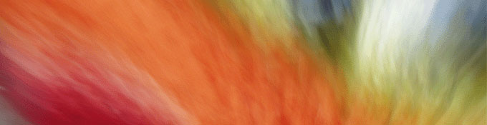
Painting
Venezuela painting took a significant turn from the pre-colonial rock carvings to religious paintings in the colonial period. The era saw a significant blend of both styles, although religion continued to be the main theme. Some of the important figures in the field of Venezuela painting and sculpture were Enrique Antonio Hernández Prieto, Antonio José Landaeta’s and Martín Tovar.
Kinetic art in Venezuela gained power in the end of the 20th century, with artists like Carlos Cruz Díez and Jesús Rafael Soto.

Slide 7
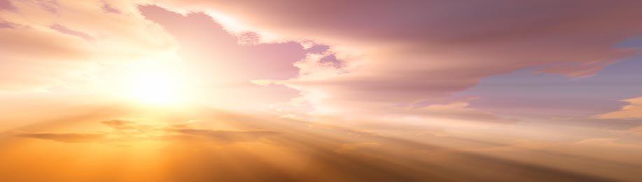
Santiago Pol
He is the # 1 graphic designer in Venezuela . He is world famous for his outstanding colorful posters and logos. Pol's work has received several awards at various international design competitions, among others from the Art Directors Club of New York.

Slide 8

Body painting is one form of art on show during Venezuela 's World Body Art Festival. The event explores various ways of using the human body as both the subject and prime material. Each model has to stand for at least six hours as the artist turns them into living paintings.

Slide 9
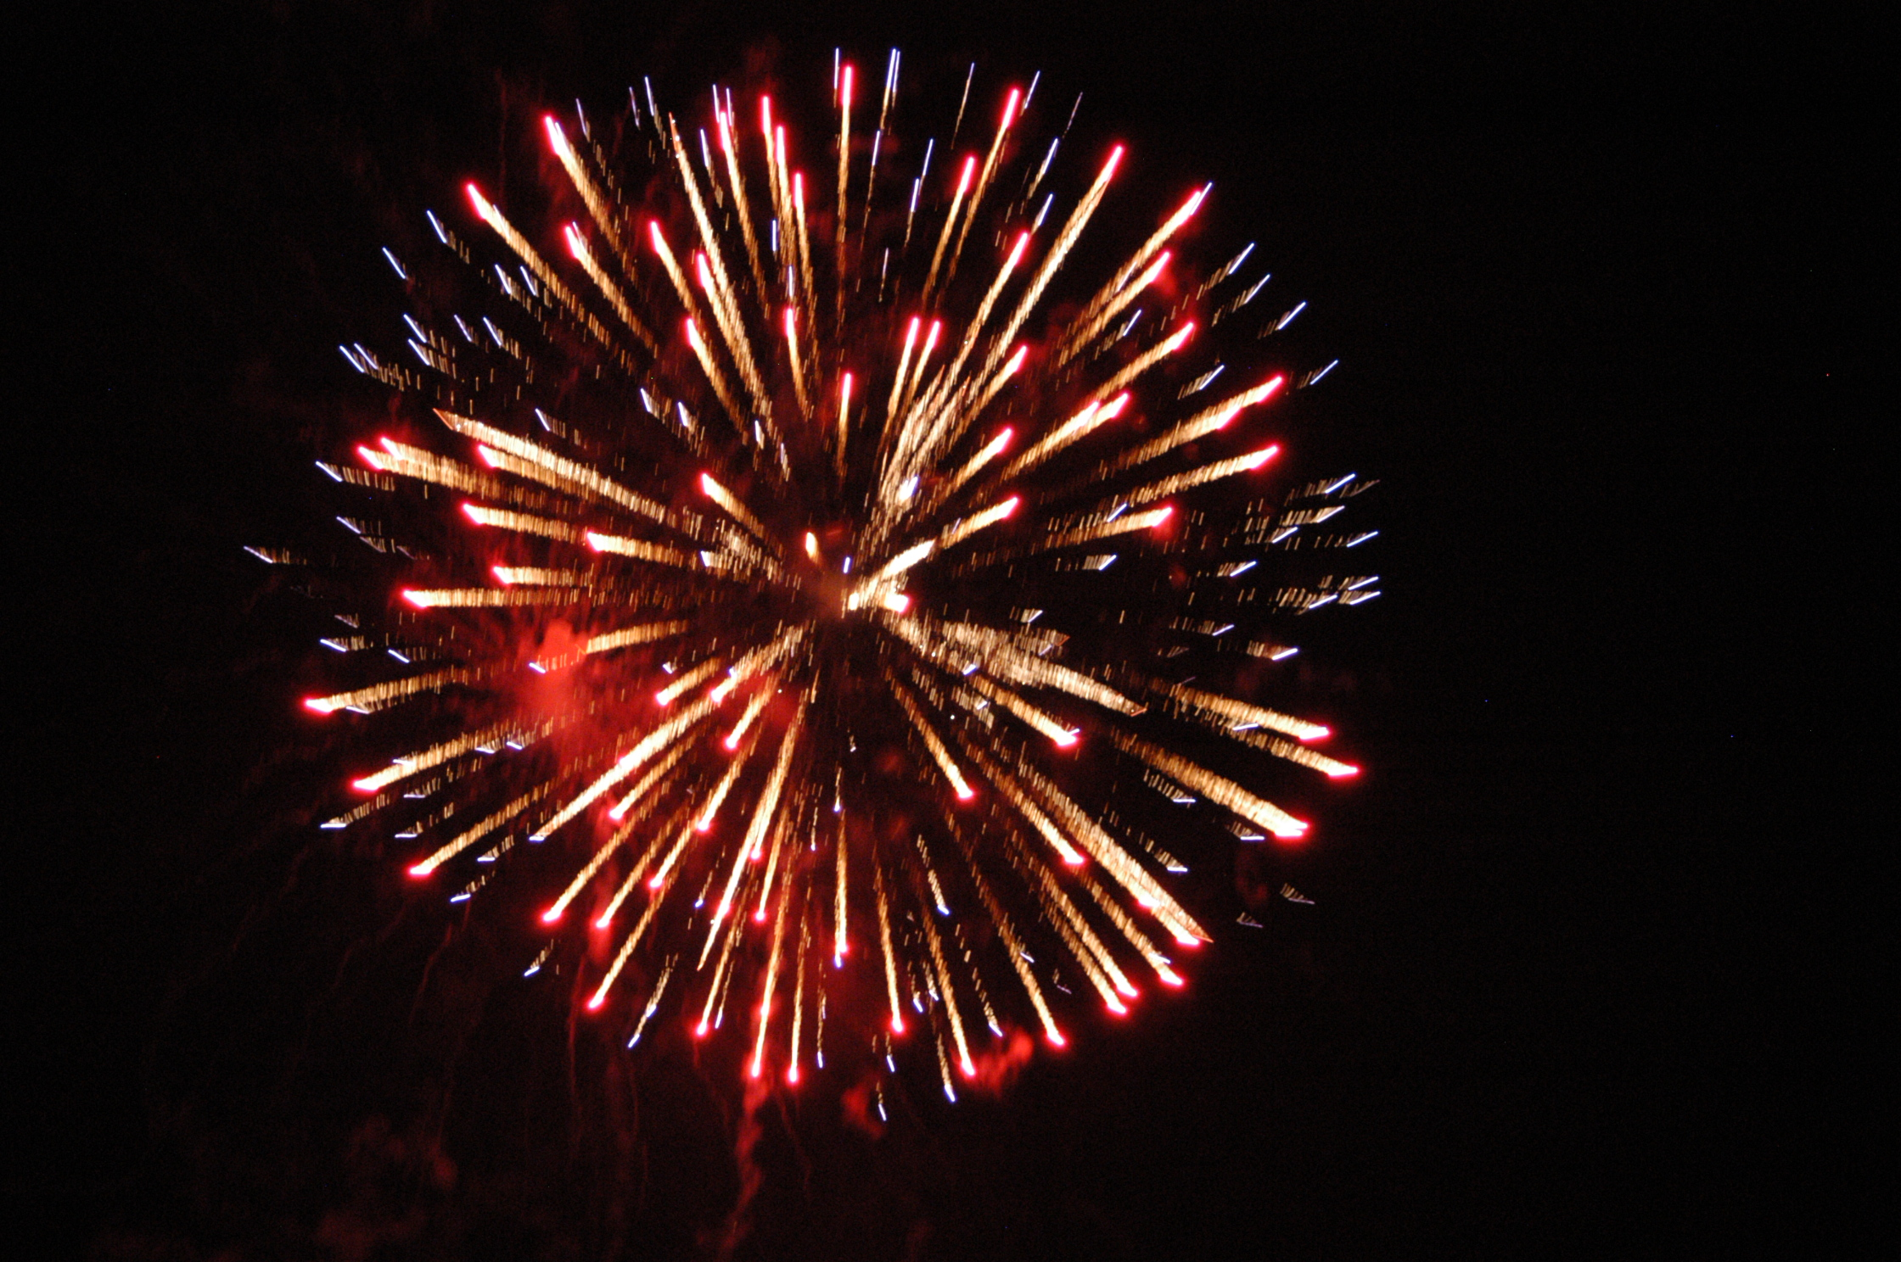
National Anthem of Venezuela
The National anthem of Venezuela is nothing other than respect for the country, as it creates a sense of pride among the citizens of Venezuela. The anthem was composed by Vicente Salias and later the music was recreated by Juan José Landaeta and finally it came to be adopted on 1881. Some believe that the real composer was Andres Bello.
The significance of this particular national anthem lies in the fact that it is a solemn representation of the patriotic feelings that led to the famous declaration of independence from the Spanish colonial rule. It was in May 25, 1881 that Antonio Guzman Blanco, who was the then President of the country, passed a decree whereby this song was officially accepted as the National anthem of the Republic of Venezuela.

Slide 10
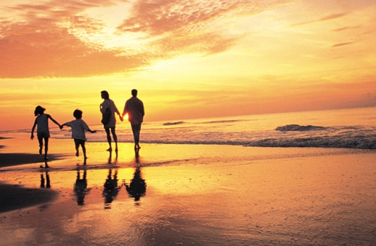
Planning to Visit
Carcass, which has long been the most talked about romantic place in South America. This capital city of Venezuela has more to offer in terms of recreation and cultural activities. Widely appreciated for its cosmopolitan and fascinating life, you will find countless architectural landmarks, museums, art galleries, theatres and home to some of the best nightclubs of the region.

